Slide 2
Hi there!
Björn Brala
CTO @ SWIS
Core maintainer for jsonapi
Maintainer of project update bot
Board member Dutch Drupal Association
bbrala

Slide 3
Dutch Digital Agency from Leiden
Sustainable digital transformations
Non-profit, government and healthcare
Love our automated updates

Slide 4
Project update bot
Good bot?

Slide 5
How did we do?
How many modules
84% of top 1000 modules are ready or have D10 patches
How many patches/issues posted and fixed
7243 issues opened
2245 issues fixed/closed (fixed)
443 RTBC

Slide 6
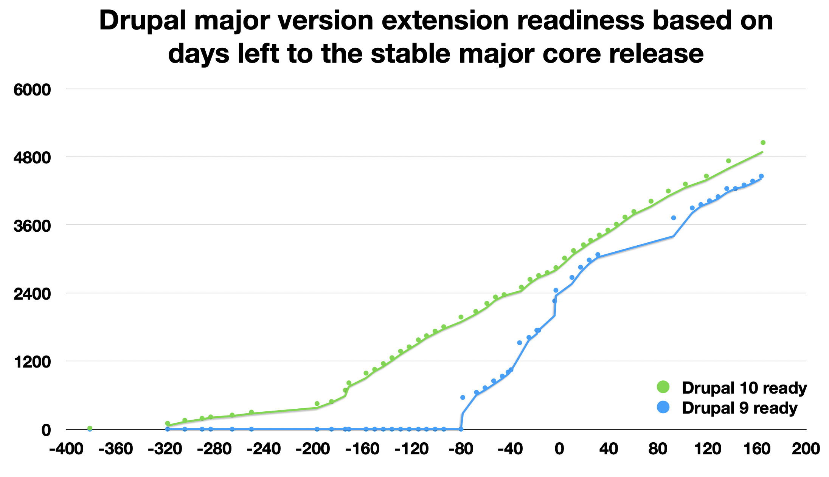
Compared to D9?

Slide 7
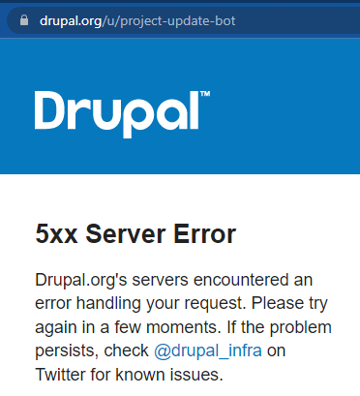
What is project update bot?
Some random guy with 4365 issue credits
u/project-update-bot
Notes:
2000 issues fixed this year

Slide 8
What is project update bot?
The face of project analysis, a collection of powerful tools
Tools
PHPStan
PHPStan Drupal
Drupal-check
Upgrade status
Rector
Drupal Rector
Projects
Project analysis
Project update bot
Aquia deprecation status dashboard

Slide 9
PHPStan Drupal
PHP static analysis tool
Finds bugs in your code without writing tests.
Finds usages of deprecated code
https://phpstan.org/
Extension for PHPStan to integrate with Drupal
mglaman/phpstan-drupal

Slide 10
Drupal check
Wrapper around PHPStan and phpstan-drupal to simplify configuration
mglaman/drupal-check

Slide 11
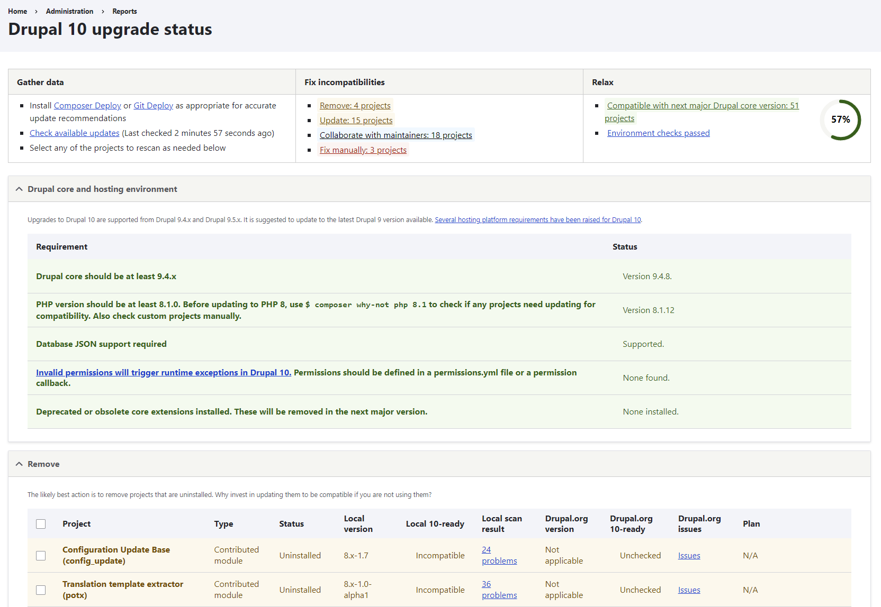
Upgrade status
Interface to analyze readiness for next major Drupal release
project/upgrade_status

Slide 12
Rector
We Turn Legacy Code into Valuable and Sustainable Code
Tooling to refactor code automatically
Support new PHP versions
Refactor classes, methods, arguments
And way more…
rectorphp/rector

Slide 13
Rector
Adding a new argument
rectorphp/rector

Slide 14
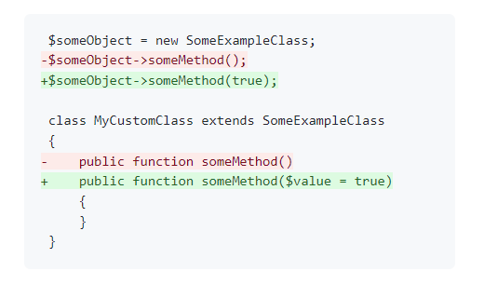
Rector
Adding a new argument
rectorphp/rector

Slide 15
Drupal Rector
Using the power of Rector to automate fixing deprecations
palantirnet/drupal-rector

Slide 16
Drupal Rector
Using the power of Rector to automate fixing deprecations
A set of deprecations for Drupal
Automated fixes where possible
palantirnet/drupal-rector

Slide 17
What is project update bot?
The face of project analysis, a collection of powerful tools
Tools
PHPStan
PHPStan Drupal
Drupal-check
Upgrade status
Rector
Drupal Rector
Projects
Project analysis
Project update bot
Aquia deprecation status dashboard

Slide 18
By their powers combined!
I am project update bot!

Slide 19
Project analysis
Automating data collection and patch generation
Why automation is important
What does it do?
The process
project/project_analysis

Slide 20
Why automation is important
Automation is driving the decline of banal and repetitive tasks.
Drupal needs modules
A lot of modules are very simple to upgrade
Upgrade with minimal effort
project/project_analysis

Slide 21
What does it do?
Project analysis in a nutshell
Scripts to install, check and patch modules
Analyses all drupal.org projects
Create patches from updated code
Store the analysis results for other tools
Runs on GitLab runners!
project/project_analysis

Slide 22
What does it do?
Project analysis in a nutshell
Runs on GitLab runners
3-hour runtime
Processes about 10.000 projects
Split to 50 separate jobs as parallel as possible
Broke git.drupal.org a few times. Sorry :x
project/project_analysis

Slide 23
Let’s go through the process
How does the analysis work?
Prepare
Analyse
Publish

Slide 24
Let’s go through the process
Analysing a single project
Install and enable the project
Run drush upgrade_status:checkstyle [module] and store XML output
Should we run rector to fix the module?

Slide 25
Let’s go through the process
Analysing a single project
Install and enable the project
Run drush upgrade_status:checkstyle [module] and store XML output
Should we run rector to fix the module?
If so; commit the project
Run rector to fix deprecations and store the output

Slide 26
Let’s go through the process
Analysing a single project
Install and enable the project
Run drush upgrade_status:checkstyle [module] and store XML output
Should we run rector to fix the module?
If so; commit the project
Run rector to fix deprecations and store the output
If git status shows changes run upgrade status again and store output
Check if the output is now clean
If so; create the patch!

Slide 27
Let’s go through…
Analysing a single project
If so; create the patch!
If so; create the patch!
If so; create the patch!
If so; create the patch!
If so; create the patch!
If so; create the patch!
If so; create the patch!
If so; create the patch!

Slide 28
Let’s go through the process
Publishing the results
All results are stored as artifacts in Gitlab
A job combines all artifacts to a single directory
Artifacts are committed to an orphan ‘results’ branch
https://git.drupalcode.org/project/project_analysis/-/tree/results
Notes:
Pro tip, don’t open in the normal interface, it will be slow.

Slide 29
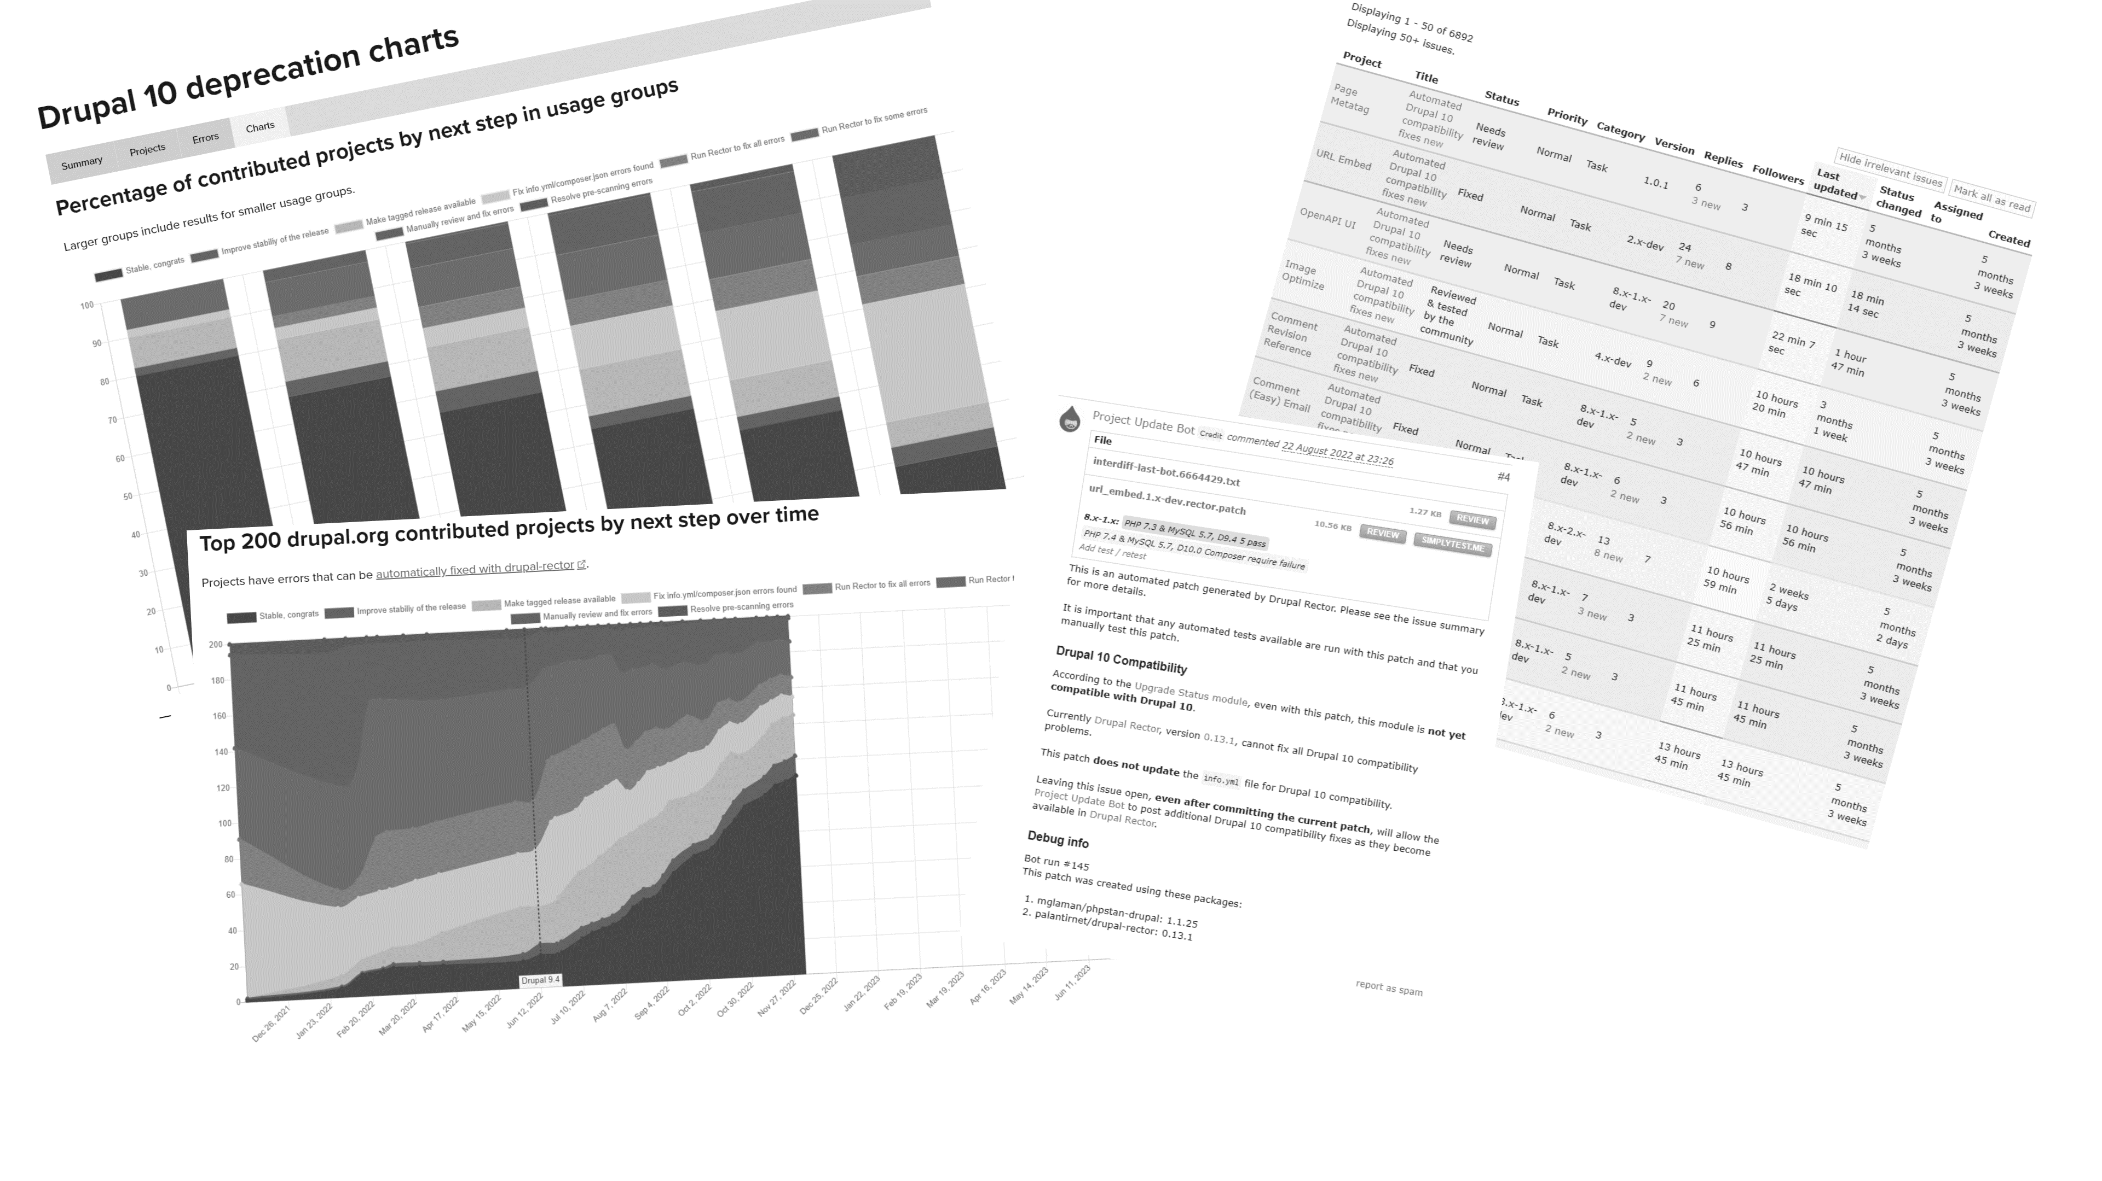
Extracting value from data
Using all this work for good

Slide 30
Drupal 10 deprecation status
https://dev.acquia.com/drupal10/deprecation_status

Slide 31
Drupal 10 deprecation status
https://dev.acquia.com/drupal10/deprecation_status

Slide 32
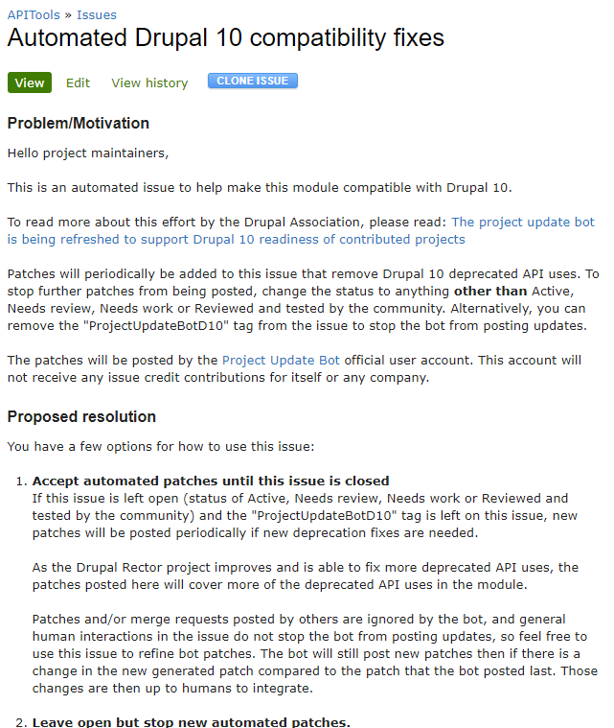
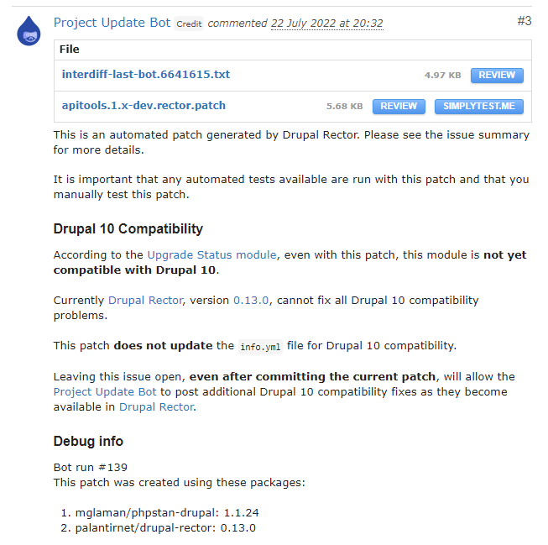
Project update bot
Super secret private repository (sorry)
Issue templates from project/project_analysis
Analyses results and posts new patches
u/project-update-bot

Slide 33
Drupal 11
Creating a maintainable pace

Slide 34
Drupal 11
Help modules fix deprecations throughout Drupal 10
It has been a rough ride for contrib and tooling maintainers alike
Break backwards compatibility in patches is a bad idea™
Successfully decoupled from D.A. infra team
We should start earlier helping maintainers

Slide 35
Drupal 11?
Start here?
Notes:
Juli upgrade upgradebot

Slide 36
Road to Drupal 11
Fully utilize Gitlab
Track deprecations
Backwards compatible fixes
Notes:
Fully utilize GitLab for project_analysis and project update bot
Track deprecations for Drupal core better
Backwards compatible fixes

Slide 37
Utilizing Gitlab
Fully utilize Gitlab
Utilize Gitlab templates to enable opt-in to frequent updates
Use merge requests instead of patches
Use Gitlab issues when available
Move the project update bot to Gitlab?
project/gitlab_templates

Slide 38
Utilizing Gitlab
Fully utilize Gitlab
Utilize Gitlab templates to enable opt-in to frequent updates
project/gitlab_templates

Slide 39
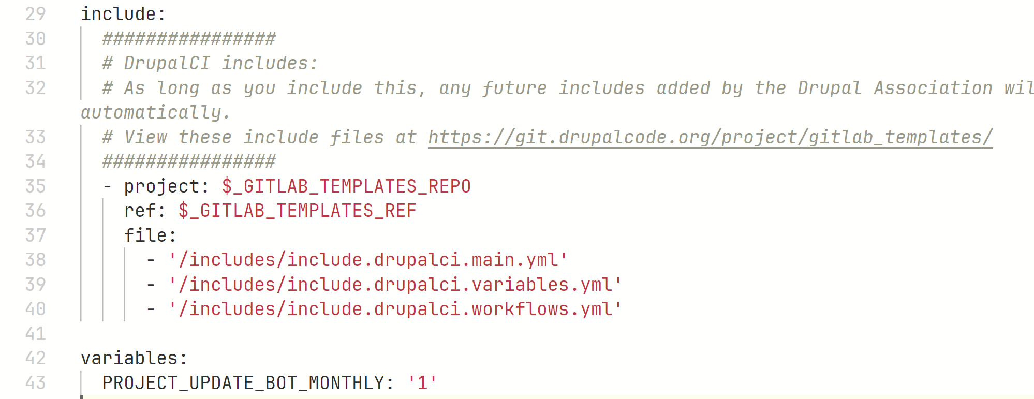
Utilizing Gitlab
Fully utilize Gitlab
Utilize Gitlab templates to enable opt-in to frequent updates
project/gitlab_templates

Slide 40
Utilizing Gitlab
Fully utilize Gitlab
Utilize Gitlab templates to enable opt-in to frequent updates
Use merge requests instead of patches
Use Gitlab issues when available
Move the project update bot to Gitlab?
project/gitlab_templates

Slide 41
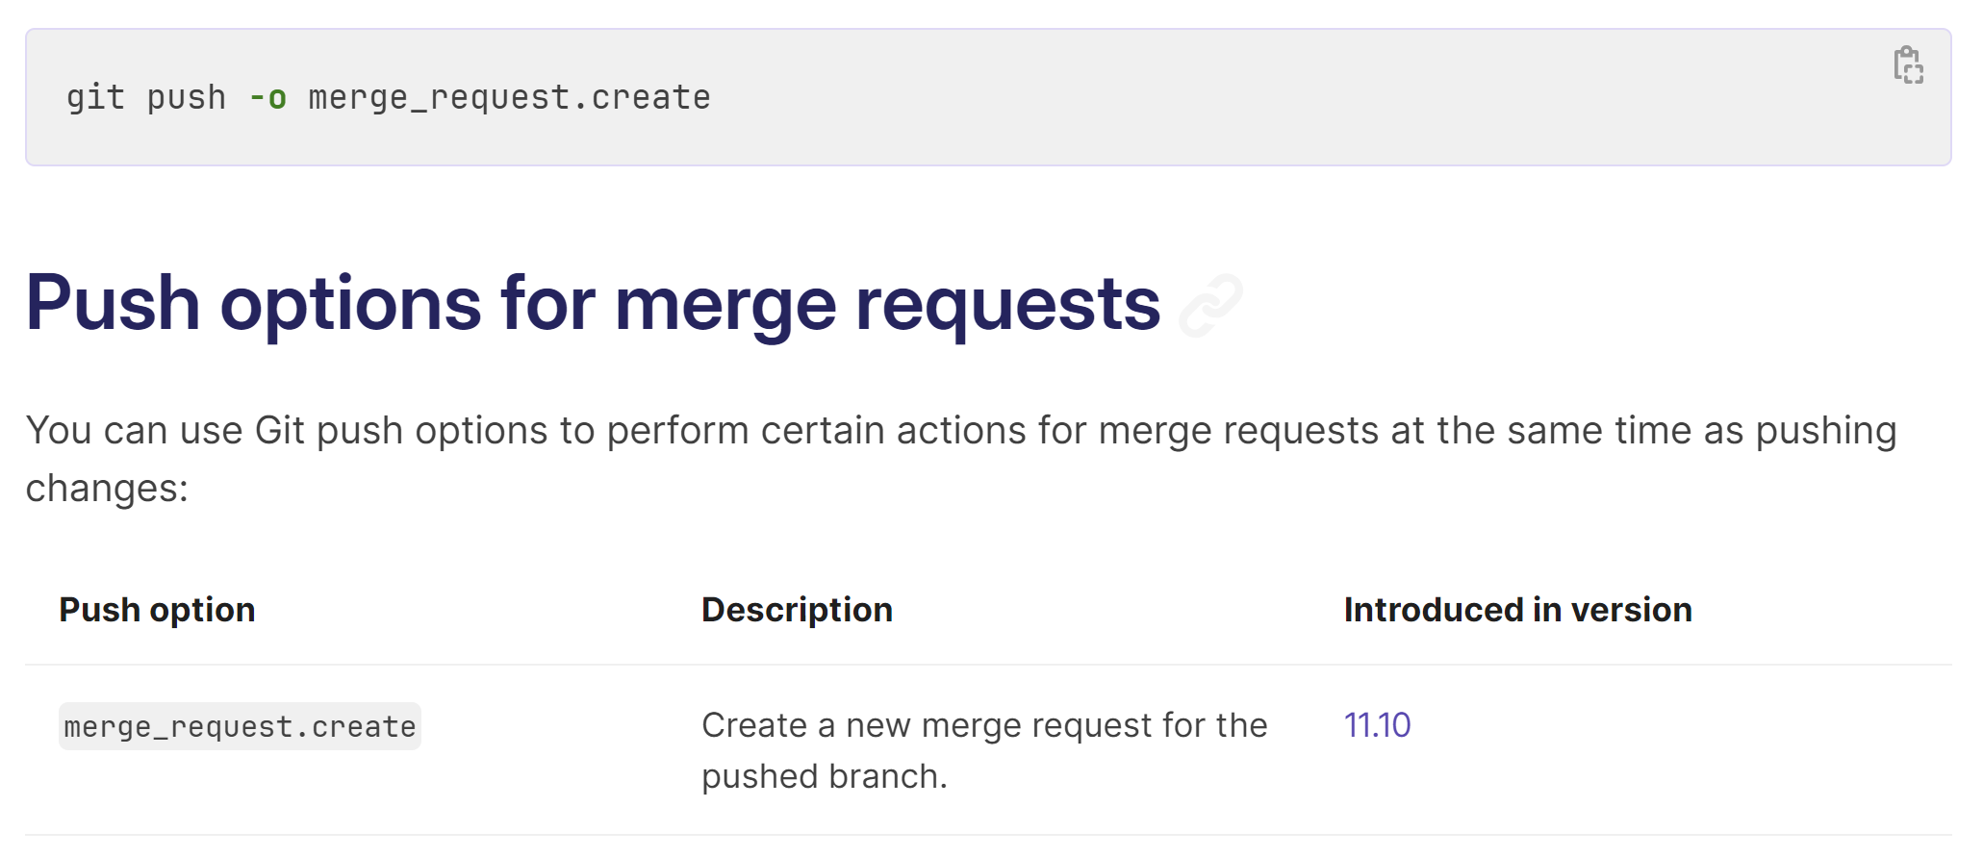
Utilizing Gitlab
Fully utilize Gitlab
Utilize Gitlab templates to enable opt-in to frequent updates
Use merge requests instead of patches
Use Gitlab issues when available
Move the project update bot to Gitlab?
project/gitlab_templates

Slide 42
Utilizing Gitlab
Fully utilize Gitlab
Utilize Gitlab templates to enable opt-in to frequent updates
Use merge requests instead of patches
Use Gitlab issues when available
Move the project update bot to Gitlab?
project/gitlab_templates

Slide 43
Road to Drupal 11
Fully utilize Gitlab
Track deprecations
Backwards compatible fixes
Notes:
Fully utilize GitLab for project_analysis and project update bot
Track deprecations for Drupal core better
Backwards compatible fixes

Slide 44
The automated fixes pipeline
Track deprecations
From the viewpoint of a human
Track new deprecations
Create relevant issues in tooling (up to 5 projects!)
Update tooling to support the deprecation
Release new versions and run project analysis
Post new patches/merge requests with project update bot
…
Profit
mglaman/drupal-change-record-triage

Slide 45
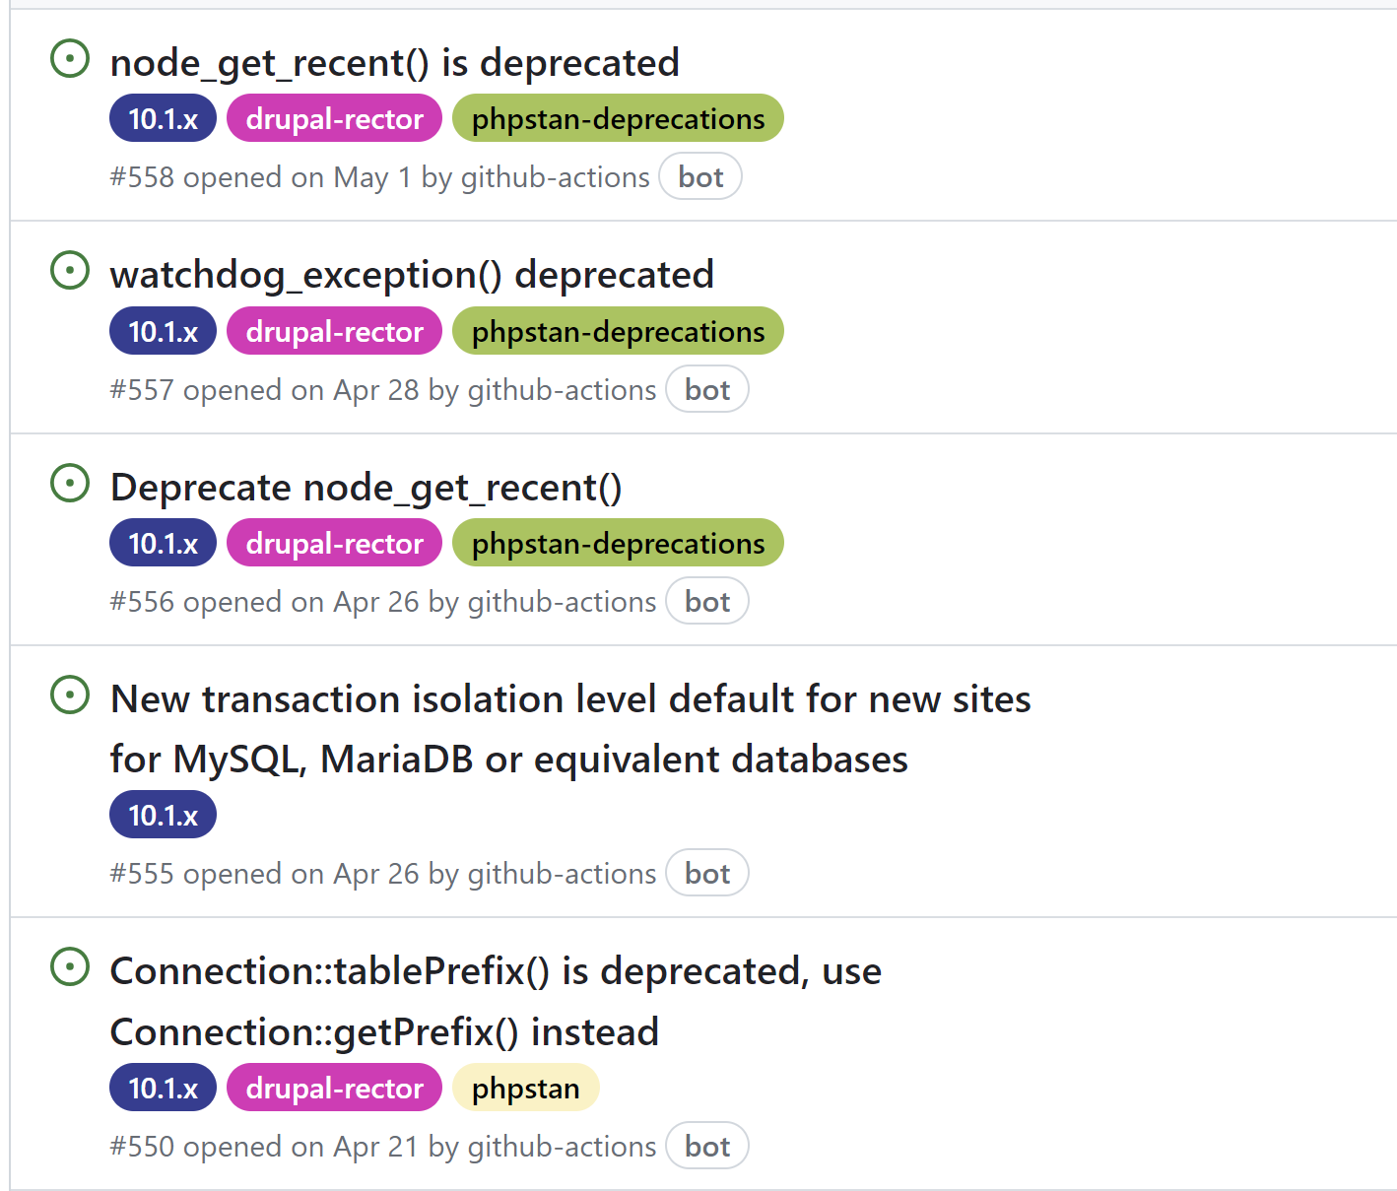
Drupal change record triage
Track deprecations
Create issues for new deprecations
Manually label the tools that are affected
Track progress of those changes
mglaman/drupal-change-record-triage

Slide 46
Road to Drupal 11
Fully utilize Gitlab
Track deprecations
Backwards compatible fixes
Notes:
Fully utilize GitLab for project_analysis and project update bot
Track deprecations for Drupal core better
Backwards compatible fixes

Slide 47
Backwards compatible fixes
Patches that work during the Drupal 10 lifecycle

Slide 48
What does BC bring?
Backwards compatible fixes
Module bad_bot:
1.4.x supports Drupal ^10.2
1.5.x supports Drupal ^11.0
Module good_bot
1.x supports Drupal ^10.2 || ^11.0

Slide 49
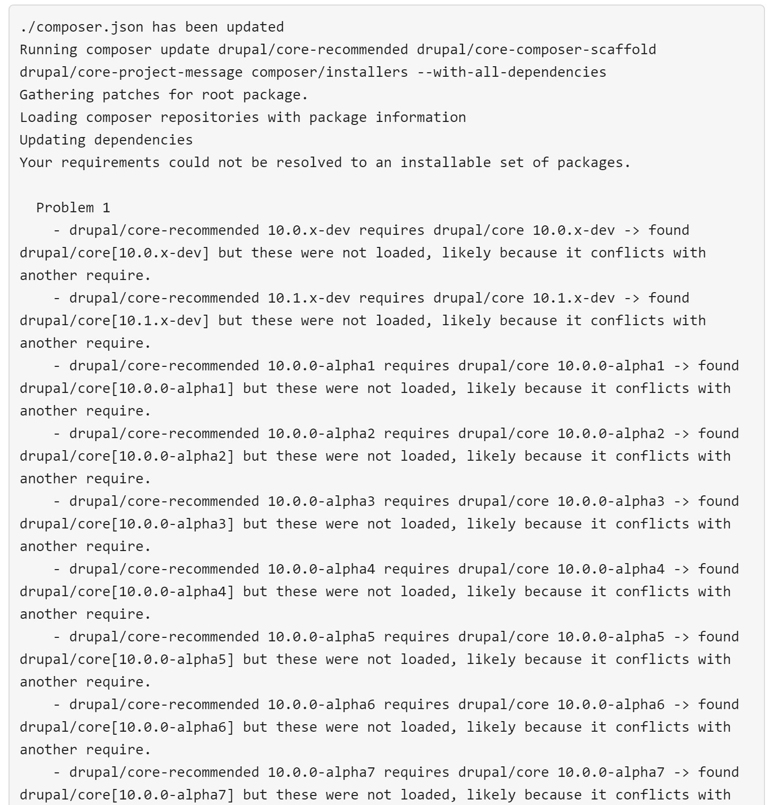
What does BC bring?
Backwards compatible fixes
Module bad_bot:
1.4.x supports Drupal ^10.2
1.5.x supports Drupal ^11.0
Module good_bot
1.x supports Drupal ^10.2 || ^11.0

Slide 50
Backwards compatible fixes
Backwards compatible fixes
Patches that work during the Drupal 10 lifecycle
Patches should be backwards compatible
Rector can do this, but we need to develop this for Drupal
Generate BC-compatible and breaking patches

Slide 51
Road to Drupal 11
Fully utilize Gitlab
Track deprecations
Backwards compatible fixes
Notes:
Fully utilize GitLab for project_analysis and project update bot
Track deprecations for Drupal core better
Backwards compatible fixes

Slide 52
Helping out
Slack
#d10readiness / #d11readiness
#rector
#phpstan
Get all your modules released!
Drupal 10 project adoption (#3342443)
bbrala

